Slide 1
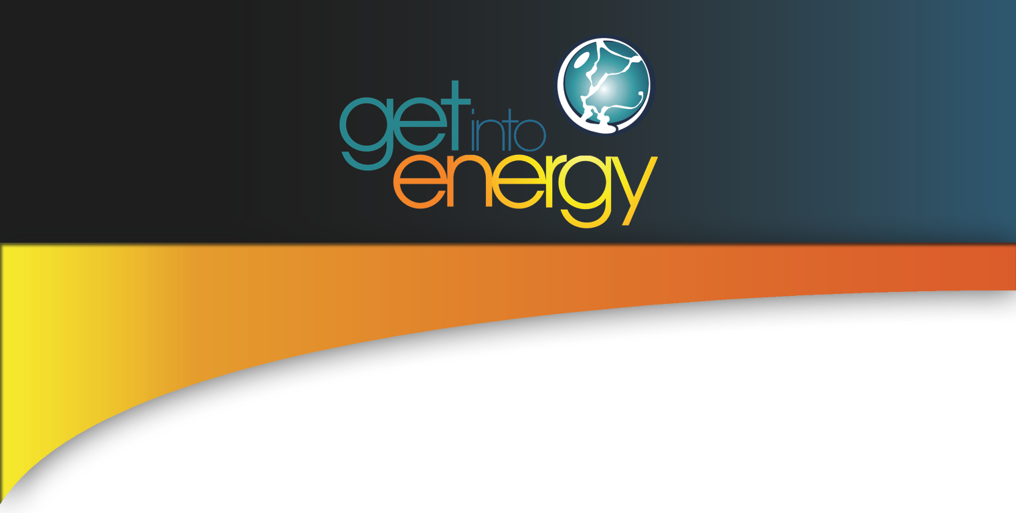
Notes:
Today we’re going to learn more about Renewable Energy. After we learn more about it, we’ll discuss the types of jobs available in the Renewable Energy Industry.
If you want to learn more about Energy Jobs go to www.getintoenergy.com!

Slide 2
Renewable Energy
Today’s lesson will focus on Renewable Energy.
So, what is Renewable Energy?
Notes:
All content and photos are from the Energy Information Administration’s Kids Page at www.eie.doe.gov/kids.

Slide 3
Definition of Renewable Energy Resources
Renewable Energy Sources: Fuels that can be easily made or "renewed." We can never use up renewable fuels. Types of renewable fuels are hydropower (water), solar, wind, geothermal, and biomass.
Notes:
According to the Energy Information Administration, Renewable Energy Sources are defined as fuels that can be easily made or "renewed." We can never use up renewable fuels. Types of renewable fuels are hydropower (water), solar, wind, geothermal, and biomass.
Let’s find out about the types of Renewable Energy Sources that are available. Some you may have heard of, and some you have not.

Slide 4
Solar Energy
Solar energy is the sun’s rays (solar radiation) that reach the earth.
Can be used to heat water and heat spaces.
Notes:
The sun has produced energy for billions of years. Solar energy is the sun’s rays (solar radiation) that reach the earth.
Solar energy can be converted into other forms of energy, such as heat and electricity. In the 1830s, the British astronomer John Herschel used a solar thermal collector box (a device that absorbs sunlight to collect heat) to cook food during an expedition to Africa.
Today, people use the sun's energy for lots of things.
Solar energy can be converted to thermal (or heat) energy and used to:
Heat water – for use in homes, buildings, or swimming pools.
Heat spaces – inside greenhouses, homes, and other buildings.

Slide 5
Conversion to Solar Energy
Photovoltaic (PV devices) or “solar cells” – change sunlight directly into electricity.
Solar Power Plants - indirectly generates electricity when the heat from solar thermal collectors is used to heat a fluid which produces steam that is used to power a generator.
Notes:
Solar energy can be converted to electricity in two ways:
Photovoltaic (PV devices) or “solar cells” – change sunlight directly into electricity. PV systems are often used in remote locations that are not connected to the electric grid. They are also used to power watches, calculators, and lighted road signs.
Solar Power Plants - indirectly generate electricity when the heat from solar thermal collectors is used to heat a fluid which produces steam that is used to power generator. Out of the 15 known solar electric generating units operating in the United States at the end of 2006, 10 of these are in California, and 5 in Arizona. No statistics are being collected on solar plants that produce less than 1 megawatt of electricity, so there may be smaller solar plants in a number of other states.

Slide 6
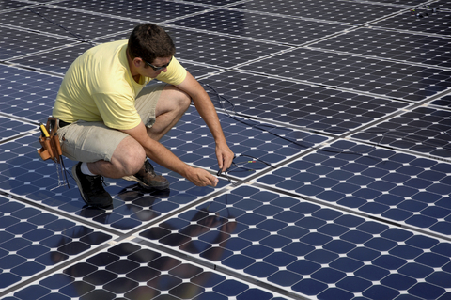
Photovoltaic (PV devices)
Notes:
Photovoltaic energy is the conversion of sunlight into electricity. A photovoltaic cell, commonly called a solar cell or PV, is the technology used to convert solar energy directly into electrical power. A photovoltaic cell is a nonmechanical device usually made from silicon alloys.
Sunlight is composed of photons, or particles of solar energy. These photons contain various amounts of energy corresponding to the different wavelengths of the solar spectrum. When photons strike a photovoltaic cell, they may be reflected, pass right through, or be absorbed. Only the absorbed photons provide energy to generate electricity. When enough sunlight (energy) is absorbed by the material (a semiconductor), electrons are dislodged from the material's atoms. Special treatment of the material surface during manufacturing makes the front surface of the cell more receptive to free electrons, so the electrons naturally migrate to the surface.
When the electrons leave their position, holes are formed. When many electrons, each carrying a negative charge, travel toward the front surface of the cell, the resulting imbalance of charge between the cell's front and back surfaces creates a voltage potential like the negative and positive terminals of a battery. When the two surfaces are connected through an external load, electricity flows. The photovoltaic cell is the basic building block of a photovoltaic system. Individual cells can vary in size from about 1 centimeter (1/2 inch) to about 10 centimeter (4 inches) across. However, one cell only produces 1 or 2 watts, which isn't enough power for most applications. To increase power output, cells are electrically connected into a packaged weather-tight module. Modules can be further connected to form an array. The term array refers to the entire generating plant, whether it is made up of one or several thousand modules. The number of modules connected together in an array depends on the amount of power output needed.
The performance of a photovoltaic array is dependent upon sunlight. Climate conditions (e.g., clouds, fog) have a significant effect on the amount of solar energy received by a photovoltaic array and, in turn, its performance. Most current technology photovoltaic modules are about 10 percent efficient in converting sunlight. Further research is being conducted to raise this efficiency to 20 percent.
The photovoltaic cell was discovered in 1954 by Bell Telephone researchers examining the sensitivity of a properly prepared silicon wafer to sunlight. Beginning in the late 1950s, photovoltaic cells were used to power U.S. space satellites (learn more about the history of photovaltaic cells). The success of PV in space generated commercial applications for this technology. The simplest photovoltaic systems power many of the small calculators and wrist watches used everyday. More complicated systems provide electricity to pump water and power communications equipment.

Slide 7
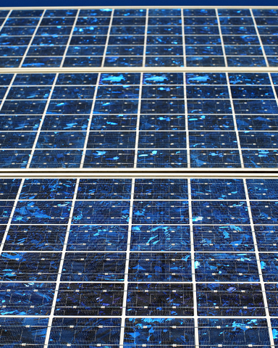
Solar Power
Notes:
Solar thermal(heat) energy is often used for heating swimming pools, heating water used in homes, and space heating of buildings. Solar space heating systems can be classified as passive or active.
Passive space heating is what happens to your car on a hot summer day. In buildings, the air is circulated past a solar heat surface(s) and through the building by convection (i.e. less dense warm air tends to rise while more dense cooler air moves downward) . No mechanical equipment is needed for passive solar heating.
Active heating systems require a collector to absorb and collect solar radiation. Fans or pumps are used to circulate the heated air or heat absorbing fluid. Active systems often include some type of energy storage system.
Solar collectors can be either nonconcentrating or concentrating.
1) Nonconcentrating collectors – have a collector area (i.e. the area that intercepts the solar radiation) that is the same as the absorber area (i.e., the area absorbing the radiation). Flat-plate collectors are the most common and are used when temperatures below about 200o degrees F are sufficient, such as for space heating.
2) Concentrating collectors – where the area intercepting the solar radiation is greater, sometimes hundreds of times greater, than the absorber area.

Slide 8
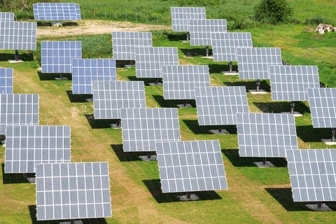
Solar Power Plants
Notes:
Solar thermal power plants use the sun's rays to heat a fluid, from which heat transfer systems may be used to produce steam. The steam, in turn, is converted into mechanical energy in a turbine and into electricity from a conventional generator coupled to the turbine. Solar thermal power generation works essentially the same as generation from fossil fuels except that instead of using steam produced from the combustion of fossil fuels, the steam is produced by the heat collected from sunlight. Solar thermal technologies use concentrator systems due to the high temperatures needed to heat the fluid.
The three main types of solar-thermal power systems are:
Parabolic trough – the most common type of plant.
Solar dish
Solar power tower

Slide 9
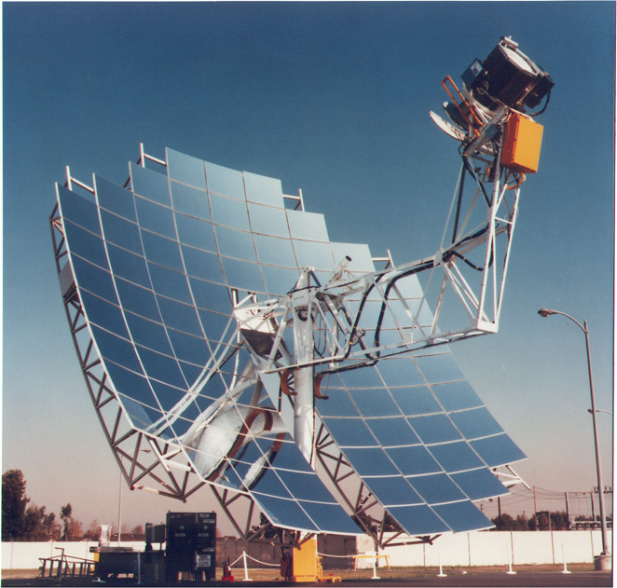
Solar Dish
Notes:
A solar dish/engine system utilizes concentrating solar collectors that track the sun on two axes, concentrating the energy at the focal point of the dish because it is always pointed at the sun. The solar dish's concentration ratio is much higher that the solar trough, typically over 2,000, with a working fluid temperature over 750oC. The power-generating equipment used with a solar dish can be mounted at the focal point of the dish, making it well suited for remote operations or, as with the solar trough, the energy may be collected from a number of installations and converted to electricity at a central point. The engine in a solar dish/engine system converts heat to mechanical power by compressing the working fluid when it is cold, heating the compressed working fluid, and then expanding the fluid through a turbine or with a piston to produce work. The engine is coupled to an electric generator to convert the mechanical power to electric power.

Slide 10
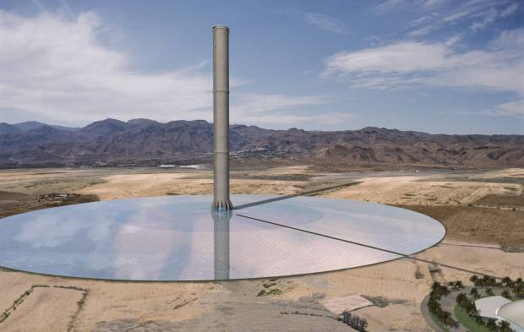
Solar Power Tower
Notes:
A solar power tower or central receiver generates electricity from sunlight by focusing concentrated solar energy on a tower-mounted heat exchanger (receiver). This system uses hundreds to thousands of flat sun-tracking mirrors called heliostats to reflect and concentrate the sun's energy onto a central receiver tower. The energy can be concentrated as much as 1,500 times that of the energy coming in from the sun. Energy losses from thermal-energy transport are minimized as solar energy is being directly transferred by reflection from the heliostats to a single receiver, rather than being moved through a transfer medium to one central location, as with parabolic troughs. Power towers must be large to be economical. This is a promising technology for large-scale grid-connected power plants. Though power towers are in the early stages of development compared with parabolic trough technology, a number of test facilities have been constructed around the world.

Slide 11
Wind Energy
Air in motion caused by uneven heating of the earth’s surface by the sun.
Large atmospheric winds that circle the earth are created because the land near the earth's equator is heated more by the sun than the land near the North and South Poles.
Notes:
Wind is simple air in motion. It is caused by the uneven heating of the earth’s surface by the sun. Since the earth’s surface is made of very different types of land and water, it absorbs the sun’s heat at different rates.
During the day, the air above the land heats up more quickly than the air over water. The warm air over the land expands and rises, and the heavier, cooler air rushes in to take its place, creating winds. At night, the winds are reversed because the air cools more rapidly over land than over water.
In the same way, the large atmospheric winds that circle the earth are created because the land near the earth's equator is heated more by the sun than the land near the North and South Poles.
Today, wind energy is mainly used to generate electricity. Wind is called a renewable energy source because the wind will blow as long as the sun shines.

Slide 12
Wind Machines
Two types of wind machines (turbines) used today based on the direction of the rotating shaft (axis)
Horizontal-axis (most common)
Vertical-axis
Clusters of wind machines are called Wind Farms
Notes:
There are two types of wind machines (turbines) used today based on the direction of the rotating shaft (axis): horizontal–axis wind machines and vertical-axis wind machines. The size of wind machines varies widely. Small turbines used to power a single home or business may have a capacity of less than 100 kilowatts. Some large commercial sized turbines may have a capacity of 5 million watts, or 5 megawatts. Larger turbines are often grouped together into wind farms that provide power to the electrical grid.
Horizontal-axis
Most wind machines being used today are the horizontal-axis type. Horizontal-axis wind machines have blades like airplane propellers. A typical horizontal wind machine stands as tall as a 20-story building and has three blades that span 200 feet across. The largest wind machines in the world have blades longer than a football field! Wind machines stand tall and wide to capture more wind.
Vertical-axis
Vertical–axis wind machines have blades that go from top to bottom and the most common type (Darrieus wind turbine) looks like a giant two-bladed egg beaters. The type of vertical wind machine typically stands 100 feet tall and 50 feet wide. Vertical-axis wind machines make up only a very small percent of the wind machines used today.
The Wind Amplified Rotor Platform (WARP) is a different kind of wind system that is designed to be more efficient and use less land than wind machines in use today. The WARP does not use large blades; instead, it looks like a stack of wheel rims. Each module has a pair of small, high capacity turbines mounted to both of its concave wind amplifier module channel surfaces. The concave surfaces channel wind toward the turbines, amplifying wind speeds by 50 percent or more. Eneco, the company that designed WARP, plans to market the technology to power offshore oil platforms and wireless telecommunications systems.
Wind power plants, or wind farms as they are sometimes called, are clusters of wind machines used to produce electricity. A wind farm usually has dozens of wind machines scattered over a large area. The world's largest wind farm, the Horse Hollow Wind Energy Center in Texas, has 421 wind turbines that generate enough electricity to power 220,000 homes per year.

Slide 13
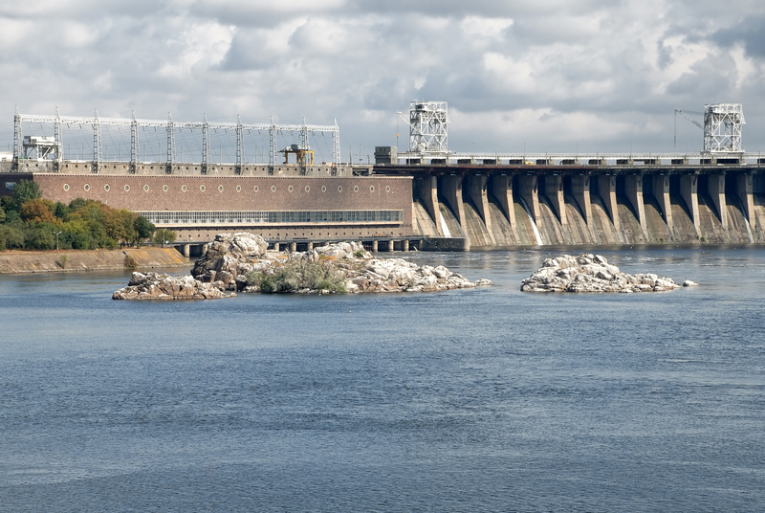
Hydropower Energy
Accounts for 6% of the total U.S electricity generated and 71% of generated renewables.
Notes:
Of the renewable energy sources that generate electricity, hydropower is the most often used. It accounted for 6 percent of total U.S. electricity generation and 71 percent of generation from renewables in 2007.
It is one of the oldest sources of energy and was used thousands of years ago to turn a paddle wheel for purposes such as grinding grain. Our nation’s first industrial use of hydropower to generate electricity occurred in 1880, when 16 brush-arc lamps were powered using a water turbine at the Wolverine Chair Factory in Grand Rapids, Michigan. The first U.S. hydroelectric power plant opened on the Fox River near Appleton, Wisconsin, on September 30, 1882. Until that time, coal was the only fuel used to produce electricity. Because the source of hydropower is water, hydroelectric power plants must be located on a water source. Therefore, it wasn’t until the technology to transmit electricity over long distances was developed that hydropower became widely used.

Slide 14
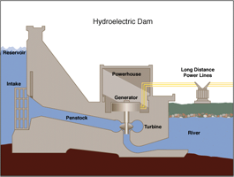
Hydropower
Notes:
Understanding the water cycle is important to understanding hydropower. In the water cycle - Solar energy heats water on the surface, causing it to evaporate. This water vapor condenses into clouds and falls back onto the surface as precipitation.
The water flows through rivers back into the oceans, where it can evaporate and begin the cycle over again. Mechanical energy is derived by directing, harnessing, or channeling moving water. The amount of available energy in moving water is determined by its flow or fall.Swiftly flowing water in a big river, like the Columbia River along the border between Oregon and Washington, carries a great deal of energy in its flow. So, too, with water descending rapidly from a very high point, like Niagara Falls in New York. In either instance, the water flows through a pipe, or penstock, then pushes against and turns blades in a turbine to spin a generator to produce electricity. In a run-of-the-river system, the force of the current applies the needed pressure, while in a storage system, water is accumulated in reservoirs created by dams, then released when the demand for electricity is high. Meanwhile, the reservoirs or lakes are used for boating and fishing, and often the rivers beyond the dams provide opportunities for whitewater rafting and kayaking. Hoover Dam, a hydroelectric facility completed in 1936 on the Colorado River between Arizona and Nevada, created Lake Mead, a 110-mile-long national recreational area that offers water sports and fishing in a desert setting.
Over one-half of the total U.S. hydroelectric capacity for electricity generation is concentrated in three States (Washington, California and Oregon) with approximately 27 percent in Washington, the location of the Nation’s largest hydroelectric facility – the Grand Coulee Dam.

Slide 15
Geothermal Energy
Heat from the earth
Uses the steam and hot water produced inside the earth to heat buildings or generate electricity.
Is a renewable energy source because the water is replenished by rainfall and the heat is continuously produced inside the earth.
Notes:
The word geothermal comes from the Greek words geo (earth) and therme (heat). So, geothermal energy is heat from within the earth. We can use the steam and hot water produced inside the earth to heat buildings or generate electricity. Geothermal energy is a renewable energy source because the water is replenished by rainfall and the heat is continuously produced inside the earth.

Slide 16
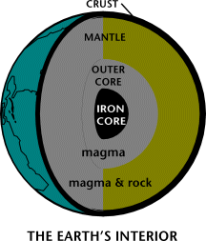
How Geothermal Energy is Generated
Notes:
Geothermal energy is generated in the earth's core, about 4,000 miles below the surface. Temperatures hotter than the sun's surface are continuously produced inside the earth by the slow decay of radioactive particles, a process that happens in all rocks.
The earth has a number of different layers:
The core itself has two layers: a solid iron core and an outer core made of very hot melted rock, called magma.
The mantle which surrounds the core and is about 1,800 miles thick. It is made up of magma and rock.
The crust is the outermost layer of the earth, the land that forms the continents and ocean floors. It can be three to five miles thick under the oceans and 15 to 35 miles thick on the continents.
The earth's crust is broken into pieces called plates. Magma comes close to the earth's surface near the edges of these plates. This is where volcanoes occur. The lava that erupts from volcanoes is partly magma. Deep underground, the rocks and water absorb the heat from this magma. The temperature of the rocks and water get hotter and hotter as you go deeper underground.
People around the world use geothermal energy to heat their homes and to produce electricity by digging deep wells and pumping the heated underground water or steam to the surface. Or, we can make use of the stable temperatures near the surface of the earth to heat and cool buildings

Slide 17
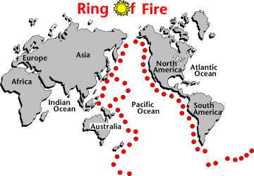
Where do we find Geothermal Energy?
Notes:
Most geothermal reservoirs are deep underground with no visible clues showing above ground. Geothermal energy can sometimes find its way to the surface in the form of: volcanoes and fumaroles (holes where volcanic gases are released), hot springs and geysers.
The most active geothermal resources are usually found along major plate boundaries where earthquakes and volcanoes are concentrated. Most of the geothermal activity in the world occurs in an area called the Ring of Fire. This area rims the Pacific Ocean.
When magma comes close to the surface it heats ground water found trapped in porous rock or water running along fractured rock surfaces and faults. Such hydrothermal resources have two common ingredients: water (hydro) and heat (thermal). Naturally occurring large areas of hydrothermal resources are called geothermal reservoirs. Geologists use different methods to look for geothermal reservoirs. Drilling a well and testing the temperature deep underground is the only way to be sure a geothermal reservoir really exists.
Most of the geothermal reservoirs in the United States are located in the western states, Alaska, and Hawaii. California is the state that generates the most electricity from geothermal energy. The Geysers dry steam reservoir in northern California is the largest known dry steam field in the world. The field has been producing electricity since 1960.

Slide 18
Uses of Geothermal Energy
1) Direct Use and District Heating Systems
2) Electricity Generation
3) Geothermal Heat Pumps
Notes:
Some applications of geothermal energy use the earth's temperatures near the surface, while others require drilling miles into the earth. The three main uses of geothermal energy are:
1) Direct Use and District Heating Systems which use hot water from springs or reservoirs near the surface. 2) Electricity generation in a power plant requires water or steam at very high temperature (300 to 700 degrees Fahrenheit). Geothermal power plants are generally built where geothermal reservoirs are located within a mile or two of the surface. 3) Geothermal heat pumps use stable ground or water temperatures near the earth's surface to control building temperatures above ground.

Slide 19
Geothermal Plants & Heat Pumps
Types of Geothermal Plants
Dry Steam Plants
Flash Steam Plants
Binary Power Plants
Geothermal heat pumps are the most energy-efficient, environmentally clean, and cost-effective systems for temperature control.
Notes:
Geothermal power plants use hydrothermal resources which have two common ingredients: water (hydro) and heat (thermal). Geothermal plants require high temperature (300 to 700 degrees Fahrenheit) hydrothermal resources that may come from either dry steam wells or hot water wells. We can use these resources by drilling wells into the earth and piping the steam or hot water to the surface. Geothermal wells are one to two miles deep.
The United States generates more geothermal electricity than any other country but the amount of electricity it produces is less than 0.5% of electricity produced in United States. Only four states have geothermal power plants:
California - has 35 geothermal power plants that produce almost 90 percent of the nation's geothermal electricity.
Nevada - has 17 geothermal power plants.
Hawaii and Utah - each have one geothermal plant
There are three basic types of geothermal power plants:
Dry steam plants - use steam piped directly from a geothermal reservoir to turn the generator turbines. The first geothermal power plant was built in 1904 in Tuscany, Italy at a place where natural steam was erupting from the earth.
Flash steam plants - take high-pressure hot water from deep inside the earth and convert it to steam to drive the generator turbines. When the steam cools, it condenses to water and is injected back into the ground to be used over and over again. Most geothermal power plants are flash plants.
Binary power plants - transfer the heat from geothermal hot water to another liquid. The heat causes the second liquid to turn to steam which is used to drive a generator turbine.
While temperatures above ground change a lot from day to day and season to season, temperatures in the upper 10 feet of the Earth's surface hold nearly constant between 50 and 60 degrees Fahrenheit. For most areas, this means that soil temperatures are usually warmer than the air in winter and cooler than the air in summer. Geothermal heat pumps use the Earth's constant temperatures to heat and cool buildings. They transfer heat from the ground (or water) into buildings in winter and reverse the process in the summer.
According to the U.S. Environmental Protection Agency (EPA), geothermal heat pumps are the most energy-efficient, environmentally clean, and cost-effective systems for temperature control. Although, most homes still use traditional furnaces and air conditioners, geothermal heat pumps are becoming more popular. In recent years, the U.S. Department of Energy along with the EPA have partnered with industry to promote the use of geothermal heat pumps.

Slide 20
Biomass Energy
Biomass is organic material made from plants and animals.
Biomass can be converted to other usable forms of energy like methane gas or transportation fuels like ethanol and biodiesel.
Notes:
Biomass is organic material made from plants and animals. Biomass contains stored energy from the sun. Plants absorb the sun's energy in a process called photosynthesis. The chemical energy in plants gets passed on to animals and people that eat them. Biomass is a renewable energy source because we can always grow more trees and crops, and waste will always exist. Some examples of biomass fuels are wood, crops, manure, and some garbage.
When burned, the chemical energy in biomass is released as heat. If you have a fireplace, the wood you burn in it is a biomass fuel. Wood waste or garbage can be burned to produce steam for making electricity, or to provide heat to industries and homes.
Burning biomass is not the only way to release its energy. Biomass can be converted to other usable forms of energy like methane gas or transportation fuels like ethanol and biodiesel. Methane gas is the main ingredient of natural gas. Smelly stuff, like rotting garbage, and agricultural and human waste, release methane gas - also called "landfill gas" or "biogas." Crops like corn and sugar cane can be fermented to produce the transportation fuel, ethanol. Biodiesel, another transportation fuel, can be produced from left-over food products like vegetable oils and animal fats.
Biomass fuels provide about 3 percent of the energy used in the United States. People in the USA are trying to develop ways to burn more biomass and less fossil fuels. Using biomass for energy can cut back on waste and support agricultural products grown in the United States. Biomass fuels also have a number of environmental benefits.

Slide 21
Forms of Biomass
Wood and wood waste are the most common forms.
Municipal solid waste, landfill gas and biogas are other forms.
Notes:
The most common form of biomass is wood. For thousands of years people have burned wood for heating and cooking. Wood was the main source of energy in the U.S. and the rest of the world until the mid-1800s. Biomass continues to be a major source of energy in much of the developing world. In the United States wood and waste (bark, sawdust, wood chips, and wood scrap) provide only about 2 percent of the energy we use today.
About 84 percent of the wood and wood waste fuel used in the United States is consumed by the industry, electric power producers, and commercial businesses. The rest, mainly wood, is used in homes for heating and cooking.
Many manufacturing plants in the wood and paper products industry use wood waste to produce their own steam and electricity. This saves these companies money because they don't have to dispose of their waste products and they don't have to buy as much electricity. The photograph to the right is of biomass fuel, probably wood chips, being stored and dried for later use in a boiler.
Another source of biomass is our garbage, also called municipal solid waste (MSW). Trash that comes from plant or animal products is biomass. Food scraps, lawn clippings, and leaves are all examples of biomass trash. Materials that are made out of glass, plastic, and metals are not biomass because they are made out of non-renewable materials. MSW can be a source of energy by either burning MSW in waste-to-energy plants, or by capturing biogas. In waste-to-energy plants, trash is burned to produce steam that can be used either to heat buildings or to generate electricity.
In landfills, biomass rots and releases methane gas, also called biogas or landfill gas. Some landfills have a system that collects the methane gas so that it can be used as a fuel source. Some dairy farmers collect biogas from tanks called "digesters" where they put all of the muck and manure from their barns. Read about a field trip to a real waste-to-energy plant or learn about the history of MSW.

Slide 22
Biofuels: Fuels Made from Biomass Material
Biofuels don’t burn as much as fossil fuels.
Biofuels are cleaner burning and produce fewer air pollutants than fossil fuels.
Types of biofuels:
Ethanol
Biodiesel
Notes:
"Biofuels" are transportation fuels like ethanol and biodiesel that are made from biomass materials. These fuels are usually blended with the petroleum fuels - gasoline and diesel fuel, but they can also be used on their own. Using ethanol or biodiesel means we don't burn quite as much fossil fuel. Ethanol and biodiesel are usually more expensive than the fossil fuels that they replace but they are also cleaner burning fuels, producing fewer air pollutants.
Ethanol is an alcohol fuel made from the sugars found in grains, such as corn, sorghum, and wheat, as well as potato skins, rice, sugar cane, sugar beets, and yard clippings. Scientists are working on cheaper ways to make ethanol by using all parts of plants and trees. Farmers are experimenting with "woody crops", mostly small poplar trees and switchgrass, to see if they can grow them cheaply and abundantly. Most of the ethanol used in the United States today is distilled from corn. About 99 percent of the ethanol produced in the United States is used to make "E10" or "gasohol" a mixture of 10 percent ethanol and 90 percent gasoline. Any gasoline powered engine can use E10 but only specially made vehicles can run on E85, a fuel that is 85 percent ethanol and 15 percent gasoline.
Biodiesel is a fuel made with vegetable oils, fats, or greases - such as recycled restaurant grease. Biodiesel fuels can be used in diesel engines without changing them. It is the fastest growing alternative fuel in the United States. Biodiesel, a renewable fuel, is safe, biodegradable, and reduces the emissions of most air pollutants.

Slide 23
Discussion Questions
Which forms of Renewable Energy can we find in our geographic area?
Check out the Get Energy Active website at www.getenergyactive.org.

Slide 24
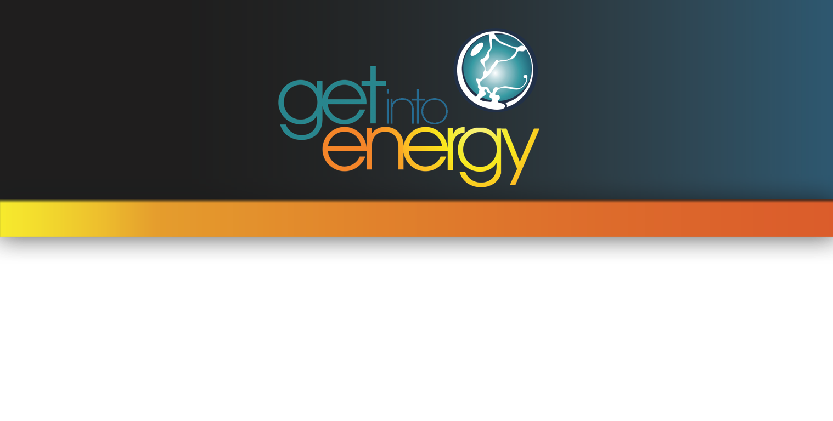
Visit www.getintoenergy.com to learn more about careers in energy!

