Slide 1
First Aid

Slide 2
Introduction
Review online course content.
Review questions.

Slide 3
Workshop Objectives
Participate in discussions, demonstrations, and hands-on activities that will enable you to:
  Explain the first aid guidelines and best practices for first responders.
  Identify:
    Basic Anatomy.
    First Aid Supplies.
  Explain the importance of using the correct personal protective equipment (PPE).
  List the actions to take in an emergency that follow the OSHA standards, and appropriate industry guidelines, e.g., American Red Cross (first aid) and the American Heart Association.

Slide 4
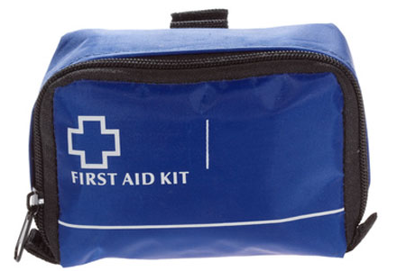
First Aid Safety on the Job
Fundamentals of basic life support
OSHA requirements for first aid
  Supplies
  Training
How to handle an incident
  Assess the accident site.
  Identify the victim.
  Evaluate the injuries.
  Request medical assistance.
  Deal with blood borne pathogens.

Slide 5


Guidelines
American Red Cross
American Heart Association
OSHA
“Good Samaritan Laws”
Notes:
http://www.martialartsnewengland.net/RedCross01.jpg

Slide 6
Basic First Aid
Know how to examine a victim.
  Look for medical identification tags.
Know the skeletal system to be able to respond, evaluate and examine victims.
Workshop Activity #1

Slide 7
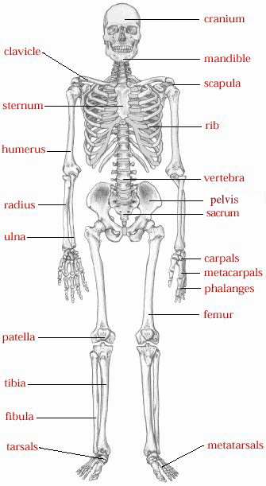
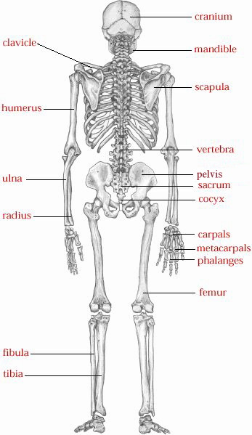
Skeletal System
Notes:
Image Retrieved July 2013 http://hes.ucfsd.org/gclaypo/skelweb/skel04.html

Slide 8
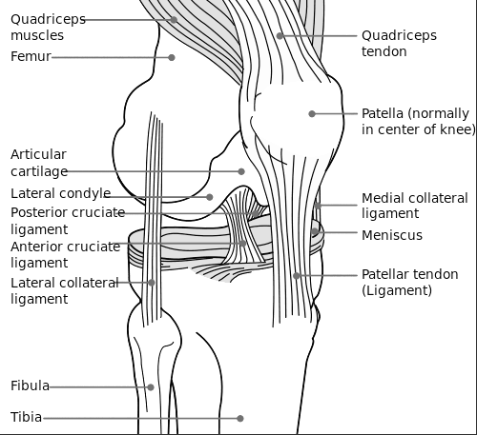
The Knee
Notes:
Image Retrieved July 2013 http://upload.wikimedia.org/wikipedia/commons/thumb/0/09/Knee_diagram.svg/500px-Knee_diagram.svg.png

Slide 9
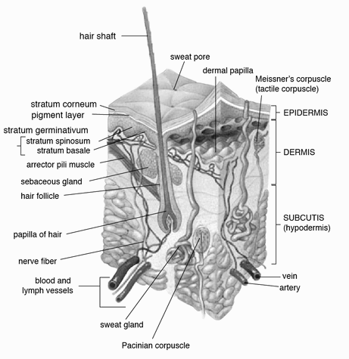
Skin Epidermal Layer
Notes:
Image Retrieved July 2013
http://upload.wikimedia.org/wikipedia/commons/thumb/2/27/Skin.png/466px-Skin.png

Slide 10
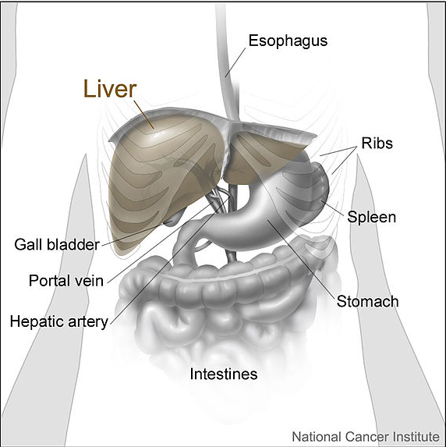
Abdominal Area
Notes:
Image Retrieved July 2013 http://commons.wikimedia.org/wiki/File:Liver_and_nearby_organs.jpg
This work has been released into the public domain by its author, Don Bliss (Illustrator)

Slide 11
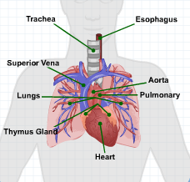
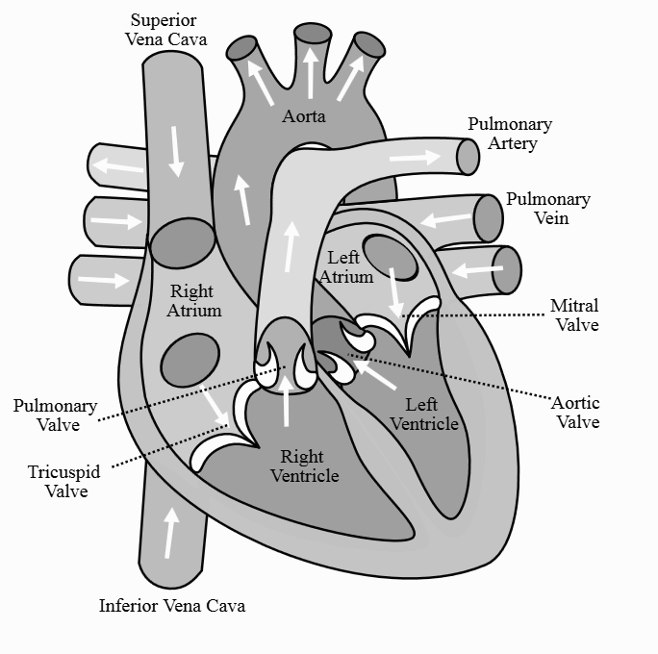
Chest Cavity
Notes:
Image Retrieved July 2013
Diagram Retrieved from Energy U-OS-0111 First Aid, Module 2-First Aid
http://commons.wikimedia.org/wiki/File:Diagram_of_the_human_heart_%28cropped%29.svg
This file is licensed under the Creative Commons Attribution-Share Alike 3.0 Unported license.

Slide 12
Response, Evaluation, and Examination
The appropriate personal protection equipment (PPE)
How to approach the victim
  Follow the “S.A.M.P.L.E.” model
    Signs and symptoms
    Allergies
    Medications
    Past history of these symptoms
    Last oral intake
    Events leading up to accident or injury

Slide 13
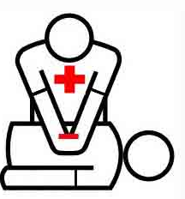

Cardiopulmonary Resuscitation CPR)
Hands-only CPR
  Compressions
  Airway
  Breathing
Automatic External Defibrillator (AED)
Notes:
Image Retrieved July 2013 http://o1.aolcdn.com/dims-shared/dims3/PATCH/format/jpg/quality/82/resize/458x295%5E/http://hss-prod.hss.aol.com/hss/storage/patch/678720078523cfd302babd67a6690962

Slide 14
Head to Toe Evaluation
Examine a victim’s:
  Head
  Face
  Neck
  Chest
  Abdomen
  Arms Legs
  Back

Slide 15
Bleeding and Wounds
Methods to control bleeding
  Find a pressure point which is important to control blood loss due to arterial bleeding.
  Apply direct pressure.
  Elevating a bleeding part with direct pressure if there are no fractures.
  Apply a non-adherent pad or dressing.
  Apply a tourniquet (last option) to stop bleeding.

Slide 16
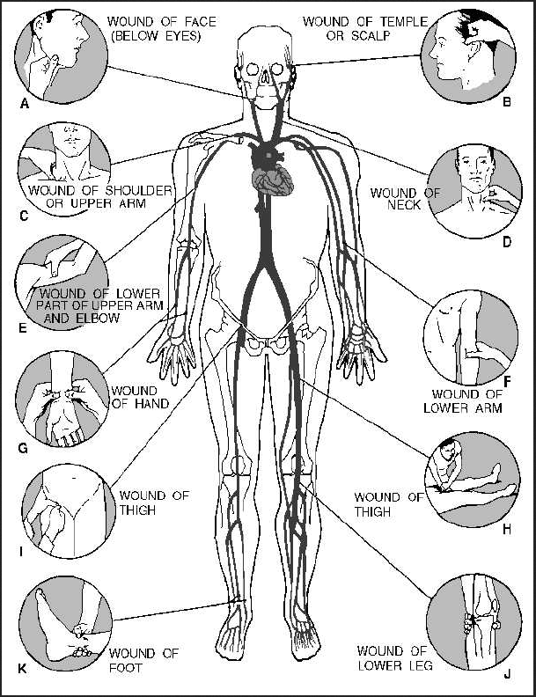
Pressure Points to Control Bleeding
Notes:
Image Retrieved July 2013 http://commons.wikimedia.org/wiki/File:Pressure_points.jpg
This file is a work of a sailor or employee of the U.S. Navy, taken or made as part of that person's official duties. As a work of the U.S. federal government, the image is in the public domain.

Slide 17
Types of Wounds
Incision
Laceration
Abrasion
Puncture
Avulsion
Amputation
Nosebleed

Slide 18
Internal Bleeding
The signs and symptoms of internal bleeding include:
  Tender, swollen, bruised area of the body
  Rapid or weak pulse
  Skin that is cool or bluish in color
  Coughing up blood
  Confused, drowsy, or unconscious

Slide 19
Shock
The signs and symptoms of shock include:
  Pale skin
  Dilated eyes
  Rapid breathing
How to treat shock

Slide 20
Burns
Burns can be classified as:
  Chemical
  Thermal
  Electrical
  Radiation
Burns are identified as:
  First degree
  Second degree
  Third degree
Scalds are caused by contact with boiling fluids or steam.

Slide 21
Electric Shock
A human body can be a conductor of electricity
The person must be disconnected from the electrical source with extreme care to no further shocks to the victim or the responder.
  Use non-conducting materials
Follow the guidelines to treat electric shock: according to your first aid training:
  Cool and cover the burns with non-adherent dressings.
  Seek medical assistance.

Slide 22
Head Injury
The signs and symptoms of shock include:
  Leaking fluid from nose or ears
  Obvious head wounds and
  Altered levels of consciousness.
  Headache
  Nausea and/or vomiting
  Confusion
  Facial bruising (around eyes and ears) is a delayed sign

Slide 23
Spinal Injury
Signs of spinal column injuries include:
  Generally slow pulse
  Unnatural position
  Body bent in awkward position
  Tingling, unusual, or absent feeling in extremities
Movement of the victim must be minimal.
Treat any wounds, shock or any other immediate injuries.

Slide 24
Fractures
A fracture is a complete break, crack, or chip in a bone and classified as:
  Open: an injury where the bone has fractured and penetrated the skin leaving a wound
  Closed: an injury where the bone has fractured but has no obvious external wound
Signs include:
  Hearing a pop or snap at the time of injury
  Pain at the site of injury
  Deformity of the limb
  Loss of use of the limb
  Bruising or swelling

Slide 25
Immobilize Fractures
A soft splint
A sling
A rigid splint

Slide 26
Poisoning
Signs that indicate poisoning:
  Unusual odors
  Open medicine cabinets
Try to identify what was swallowed, how much, and when.
Call Poison Control: 1-800-222-1222.

Slide 27
Environmental Emergencies
Heat stress
  Heat cramps
  Heat exhaustion
  Heat stroke
Extreme cold
  Hypothermia
  Frost bite

Slide 28
Insect bites, Anaphylactic Shock, and Snakebites
Insect bites
Anaphylactic shock
Snakebites
Activity Worksheet #2

Slide 29
Sources
Occupational Safety and Health Administration (OSHA)
Compressed Gas Association (CGA)
US Department of Transportation (FHWA)
Code of Federal Regulations:
  CFR 29 § 1910.151 (a) (b) (c) Medical Services and First Aid
  .

Slide 30

Open Discussion
Questions
Comments

