Slide 1
Valves

Slide 2
Introduction
Review online course content.
Review questions.

Slide 3
Workshop Objectives
Participate in discussions, demonstrations, and hands-on activities that will enable you to:
Identify types of valves.
Identify valve parts.
Open and close valves manually.
Identify maintenance requirements.
Perform maintenance.

Slide 4
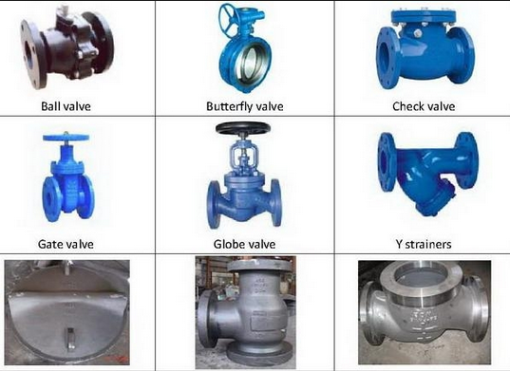
Types Of Valves
Gate
Globe
Ball
Butterfly
Check
Pinch
Diaphragm
Plug
Swing
Safety
Lift
Release
Notes:
Image Retrieved July 2013

Slide 5
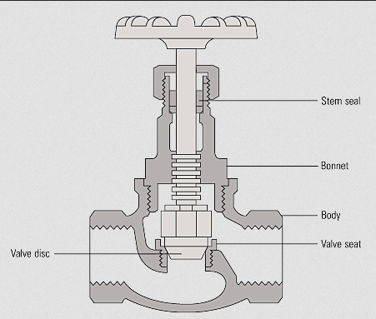
Valve Components
Body
Bonnet
Lubrication Fittings
Stem
Seat
Seal
Stop Collar
Core
Notes:
Image Retrieved July 2013 http://www.spiraxsarco.com/images/resources/steam-engineering-tutorials/12/1/fig_12_1_2.gif

Slide 6
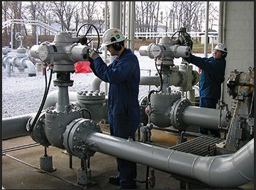
Troubleshooting a Valve
Importance of using the operating instructions
Troubleshooting
Maintenance
Procedures
Notes:
Image Retrieved July 2013 http://www.rotork.com/product/index/preventativemaintenance

Slide 7
Valve Classifications
Multi turn valves
Turn handle several times to open or close the valve
Raising or lowering valve element off or on a valve seat controls flow
¼ turn valves
¼ turn opens or closes valve
Valve element turn with the valve seat
Outside indicator (stop) shows if valve is opened or closed

Slide 8
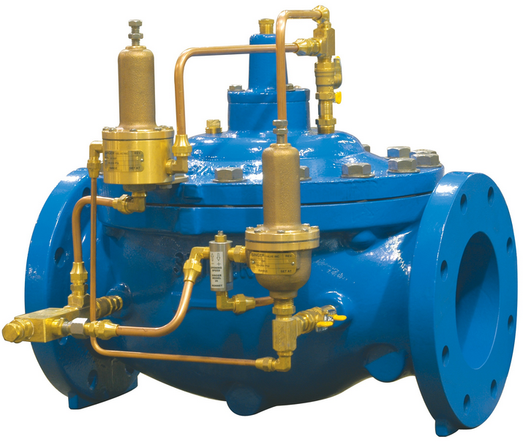
Valve Functions
Designed for specific functions
Regulating pressure
Stopping flow
Releasing overpressure
Types of Valves
Automatic
Critical (ESD)
Non-Essential
System Operation
Tap
Bypass
Main line
Notes:
Image Retrieved July 2013 http://www.mgacontrols.com/products/control-valves/pressure-reducing-valves/

Slide 9
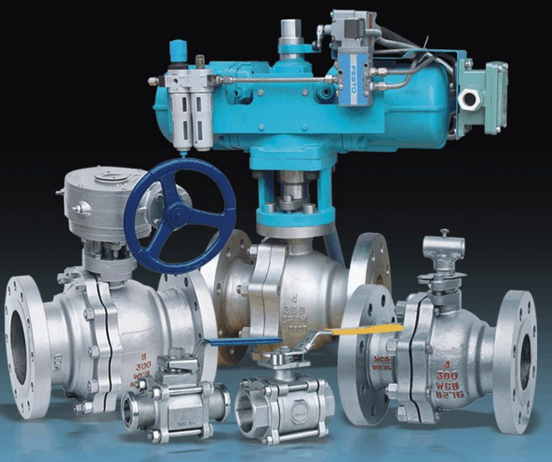
Valve Functions - Actuation
Manually operated
Electrically operated
Pneumatically operated
Hydraulically operated
Activity Worksheet #1
Notes:
Image Retrieved July 2013 http://www.fbvalve.com/uploadfiles/floating-ball-valve.jpg

Slide 10
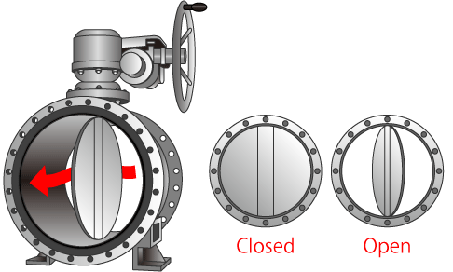
Working With Valves
Verify the valve.
Notify appropriate parties.
Isolate the valve.
Notes:
Image Retrieved July 2013 http://www.tlv.com/global/TI/steam-theory/types-of-valves.html

Slide 11
Opening and Closing a Valve
Inspect the valve.
Verify upstream and downstream pressure.
Place automatic valve in manual mode if needed.
Operate valve.
Verify upstream and downstream pressure.
Document records.
Activity Worksheet #2

Slide 12
Partial Maintenance and Inspection
Regular inspection schedule
Reveal valves not working correctly due to:
Inadequate lubrication.
Improper adjustment.
Solids in lubrication grooves.
Internal debris.
Corrosion.

Slide 13
Problem Reduction
Visual inspection
Product check
Valve verification
Valve lubrication
Valve winterization

Slide 14
Winterizing a Valve
Removing ice or snow around the valve and/or the ground box.
Remove debris from the ground box.
Adjust valve packing.
Use approved packing material.
Lubricate if needed.
Paint above ground components.

Slide 15
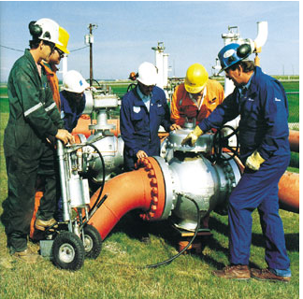
Preventive Maintenance Demonstration
Regular maintenance steps taken to ensure safety
How to conduct a preventive maintenance inspection
Notes:
Image Retrieved July 2013 http://www.utexas.edu/ce/petex/courses/newsletters/fall09/sealweld/

Slide 16
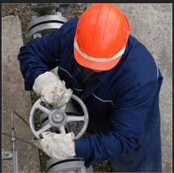
Lubricating A Valve
How to lubricate a valve taking care not to:
Over lubricate the valve
Trap air in the valve
Leave debris in the valve
Leave debris in the ground box
Activity Worksheet #3
Notes:
Image Retrieved July 2013 http://www.skf.com/group/industry-solutions/oil-gas/processing-and-refining/petroleum-and-petrochemical/valves/index.html

Slide 17
Evaluating A Valve
Discussion
Steps taken to evaluate a valve
Similarities between preventive maintenance and repair
“Real world” scenarios
Activity Worksheet #4

Slide 18
Sources
Occupational Safety and Health Administration (OSHA)
Compressed Gas Association (CGA)
US Department of Transportation (FHWA)
Code of Federal Regulations:
Review the following regulations as tasks are introduced, demonstrated, and practiced.
§192.145 Valves.
§192.179 Transmission line valves.
§192.181 Distribution line valves.
§192.193 Valve installation in plastic pipe.
§192.365 Service lines: Location of valves
§192.381 Service lines: Excess flow valve performance standards.

Slide 19
Sources, Continued
Code of Federal Regulations:
Review the following regulations as tasks are introduced, demonstrated, and practiced.
§192.615 Emergency plans.
§192.625 Odorization of gas
§192.745 Valve maintenance: Transmission lines.
§192.747 Valve maintenance: Distribution systems.
§195.116 Valves.
§195.258 Valves: General.
§195.260 Valves: Location.
§195.420 Valve maintenance.

Slide 20
Open Discussion
Questions
Comments
Notes:
§192.321 Installation of plastic pipe.
195.442 Damage prevention program.
§192.614 Damage prevention program
§198.37 State one-call damage prevention program
§192.615 Emergency plans.
§198.39 Qualifications for operation of one-call notification systems.
§192.707 Line markers for mains and transmission lines.
§1926.652 Requirements for protective systems
§195.410 Line markers.

