Slide 1
Principles of Natural Gas

Slide 2
Introduction
Review online course content.
Review questions.

Slide 3
Workshop Objectives
Participate in discussions, demonstrations, and hands-on activities that will enable you to:
Identify chemical composition and properties of natural gas.
Prepare pipes to eliminate natural gas ignition.
Capture gas samples.
Explain how to manage leaks and abnormal operating conditions (AOCs).

Slide 4
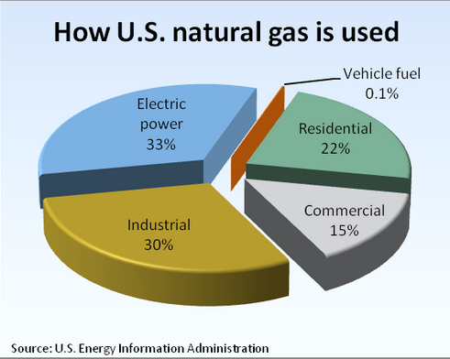
Natural Gas
How natural gas is formed, extracted and refined
How natural
gas is used
Notes:
Image Retrieved July 2013 http://www.arcticgas.gov/sites/default/files/images/How-U.S.-natural-gas-is-used-573.png

Slide 5
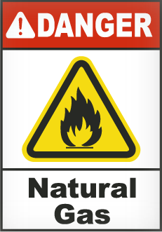
Natural Gas-Potential Dangers
Potential dangers and hazards
How fires or explosions occur
How incomplete combustion can
result in carbon monoxide poison
Symptoms of carbon monoxide
poisoning
How natural gas can cause
asphyxiation
Notes:
Image Retrieved July 2013 http://www.safetysign.com/images/catlog/product/large/G4885-natural-gas-sign.png

Slide 6
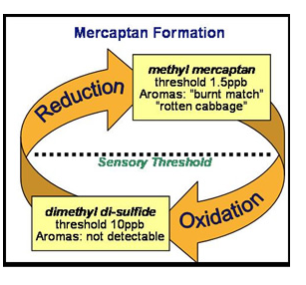
Natural Gas Properties
Chemical composition of natural gas.
Processed natural gas contains 85% to 90% methane and 10% to 15% other gases such as ethane, propane, and butane.
Characteristics
Colorless, odorless, non-toxic,
non-poisonous, lighter than air,
and combustible.
Mercaptan, an odorant, is added
before distribution to assist in
leak detection.
Notes:
Image Retrieved July 2013 http://www.etslabs.com/ContentImages/Sulfide2a.jpg

Slide 7
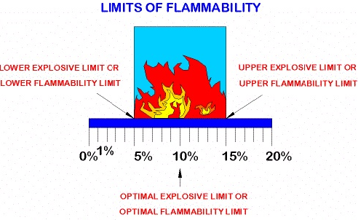
Flammability
Gas ignites when specific gas to air ratios are present.
Range of 4.5% to 14.5%
Lower Explosive Limit (LEL)
Upper Explosive Limit (UEL)
Notes:
Image Retrieved July 2013 http://www.gibsoncountygas.com/flame_graphic.jpg

Slide 8
Static Electricity
Serious potential source of ignition
Causes of static electricity
Grounding tools to prevent static electricity ignition
Coating plastic pipe to remove any electrical charge

Slide 9
Preparing Pipes
Correct Personal Protection Equipment (PPE)
Preparing plastic and metal pipes
Insulating pipes
Welding pipes
Activity Worksheet #1

Slide 10
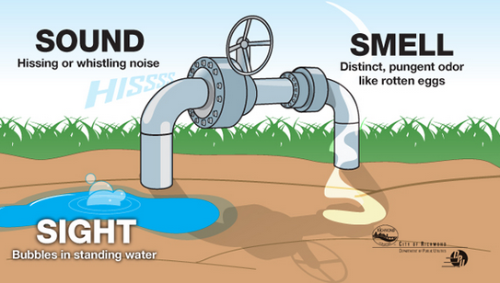
Gas Leaks
Detecting gas leaks
Use your senses
Smell
Look
Listen
Correct tools
Securing the leak site
Eliminating ignition sources
Notes:
Image Retrieved July 2013 http://www.richmondgov.com/PublicUtilities/images/LeakRecognitionAndResponse.jpg

Slide 11
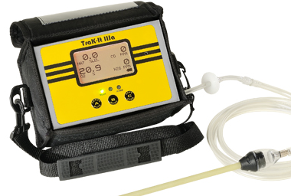
Assess a Gas Leak
Analyze gas concentration using a combustible gas
indicator (CGI)
Correct use of
the CGI
Notes:
Image Retrieved July 2013 http://www.gasleaksensors.com/products/product_images/product_trak_it_IIIa.jpg and http://www.gasleaksensors.com/products/sensit_gold_cgi.html

Slide 12
Detecting and Managing abnormal operating conditions (AOCs)
Evaluating and response to abnormal operation conditions
When to call 8-1-1 or the One-Call Center
Notes:
Image Retrieved July 2013 http://www.workplace-weekly.com/wp-content/uploads/2013/04/safe_digging.jpg

Slide 13
On the Job Scenarios
Study the case
Identify options
Evaluate options
What should you do?
Present decision and reasoning
Activity Worksheets #2 - #7
Notes:
Divide the workshop into groups of 3-5 participants to discuss the case.
When possible make sure each group has members who can lead the group, present their findings, and keep the discussion moving.
Direct the participants to the Workshop Activity sheets
Have each group pick a spokesperson to present their ideas to the class after their discussions.
After their presentations, ask questions to bring out any information not covered in their presentations to ensure the workshop objectives are covered.

Slide 14
Sources
Occupational Safety and Health Administration (OSHA)
Compressed Gas Association (CGA)
US Department of Transportation (FHWA)
Code of Federal Regulations:
§192.615 Emergency plans.
§192.625 Odorization of gas.
§192.751 Prevention of accidental ignition.

Slide 15
Open Discussion
Questions
Comments

