Slide 1
Locating Gas Structures

Slide 2
Introduction
Review online course content.
Review questions.

Slide 3
Workshop Objectives
Participate in discussions, demonstrations, and hands-on activities that will enable you to:
Conduct locate procedures through multiple methods.
Identify appropriate line markers and the characteristics which must comply with federal safety guidelines.
Interpret map and survey data, alignment drawings, and locating equipment to locate and then mark a pipeline.
Explain the safety procedures and PPE requirements that must be followed when handling buried facilities.

Slide 4
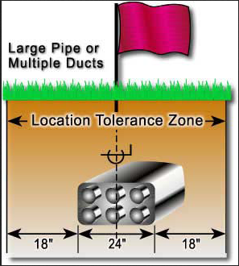
Locating Gas Structures
The excavator’s responsibilities
Inspect and locate interference.
Locate metallic and
non-metallic facilities.
Using triangulation
to determine facility depth.
Identifying and marking a
tolerance zone.
Direct connect method of
secure signals.
Notes:
Image Retrieved July 2013: http://kentucky811.org/the-dig-law

Slide 5
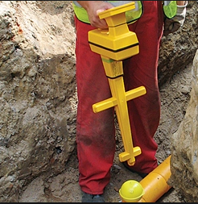
Locating Gas Structures, Continued
Electronic Markers locating
Measurement locating
Acoustic locating
Locating with Ground
Penetrating Radar (GPR)
Inductive locating
Conductive locating
Activity Worksheet #1
Notes:
Image Retrieved July 2013: http://solutions.3m.com.au/wps/portal/3M/en_AU/Oil-Gas_APAC/M-Oil-and-Gas/oil-and-gas-Solutions/midstream/midstream-pipe-locating/midstream-electronic-marker/

Slide 6
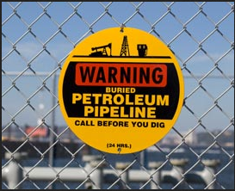
Line Marker Requirements
Above ground markers
Aerial markers
Vent markers
Transmission pipeline markers
Comply with:
Federal regulations.
International color codes.
Identifying gas or liquid transported by the pipeline.
24/7 contact telephone number.
Notes:
Image Retrieved July 2013: http://www.expl.com/Safety/GovernmentSafetyOfficials/IDPipelinesandAboveGroundFacilities.aspx

Slide 7
Line Marker Requirements (cont.)
Identify right-of-way and easement on land surveys
Correctly use maps, surveys, alignment drawings and locating equipment to locate and mark a pipeline
Activity Worksheet #2
Notes:
Image Retrieved July 2013: http://www.neb-one.gc.ca/clf-nsi/rthnb/pplctnsbfrthnb/mcknzgsprjct/rfd/rfdv2ch5-eng.html

Slide 8
Sources
Occupational Safety and Health Administration (OSHA)
Compressed Gas Association (CGA)
US Department of Transportation (FHWA)
Code of Federal Regulations:
§ 192.321 Installation of plastic pipe.
§ 195.442 Damage prevention program.
§192.614 Damage prevention program.
§198.37 State one-call damage prevention program.
§192.615 Emergency plans.
§198.39 Qualifications for operation of one-call notification systems.
§192.707 Line markers for mains and transmission lines.
§1926.652 Requirements for protective systems.
§195.410 Line markers..
.

Slide 9
Open Discussion
Questions
Comments

