Slide 1
Using Employee Resources Groups to Build a Diverse Workforce Pipeline
May 1, 2013

Slide 2
What is an Employee Resource Group (ERG)?
Company-sponsored entities, where members represent historically underrepresented populations
Commonly provide business insights, solve business problems, build leadership skills, and act as “brand ambassadors” out in their communities
Exist in 90% of Fortune 500 companies

Slide 3
What do successful ERGs look like?
They are formed by employees.
They have a mission and specific goals.
They have a focus on professional development.
They participate in community service.

Slide 4
Why support ERGs?
All 50 of Diversity Inc.’s Top Companies use their resource groups to recruit new employees.
Members of ERGs spread the word about the company being an inclusive place to work, therefore enhancing the company’s ability to attract a diverse workforce.

Slide 5
Why support ERGs?
ERGs not only can be used to attract a strong workforce, but retain them as well. They provide a way for various cultural groups to feel connected and provide mentorship opportunities.

Slide 6
How can companies best support ERGs?
Have company policies in place for ERGs
Provide an executive sponsor
Allow groups to meet during company time
Provide facilities for the groups to meet
Be willing to support the groups with resources they need to be successful

Slide 7
How can companies best support ERGs?
CEWD has a solution guide that includes how to start a new ERG, as developed by the Employer Assistance and Resource Network (EARN), part of the National Employer Technical Assistance Center www.askearn.org
Solution Guide is available at: http://www.cewd.org/workdevedu/solutionguides.asp

Slide 8


Slide 9
Background
Employee Resource Groups are a critical component of Duke Energy’s Diversity & Inclusion Strategy
Benefits to the company
  Recruitment and Retention
  Community Outreach
  Employee Engagement
Benefits to employees
  Professional development and networking opportunities
  Improved Business Acumen
  Increased cultural awareness

Slide 10
Duke Energy ERGs
Recently completed the Duke Energy and Progress Energy merger, and combined the Employee Resource Groups from both companies
We now have 5 Employee Resource Groups
  Each ERG has a Steering Committee that consists of the Executive Sponsors, Chairs and Vice Chairs from each Chapter
And… there are 20 Chapters within the 5 ERGs
  Each Chapter has an 8-person Officer Team and an Executive Sponsor
  Membership ranges from 150 – 700 employees, per Chapter

Slide 11





Duke Energy ERGs
(5 Chapters)
(6 Chapters)
(3 Chapters)
(2 Chapters)
(4 Chapters)

Slide 12
ERG Operating Guidelines
Forming an ERG or Chapter
ERG Organizational Structure
Officer Succession Planning Process
Membership and Participation
Funding
Solicitation & Distribution Policies
Supporting Company Resources

Slide 13
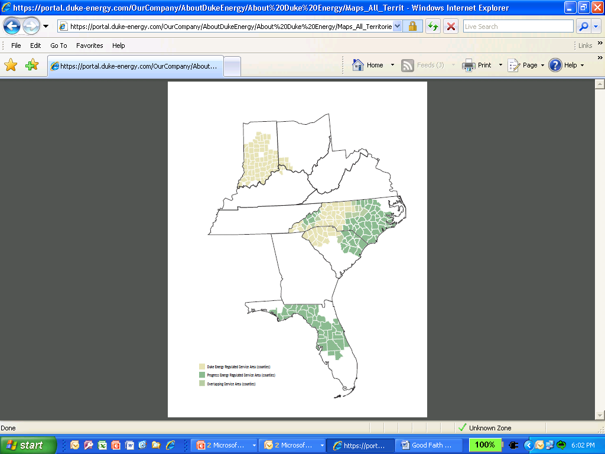
Focus ERG
Five Chapters:
  Indiana
  Cincinnati
  Charlotte
  Raleigh
  Florida

Slide 14
Mission
Create an environment of advocacy that supports Duke Energy’s effort to attract, develop, engage and retain African-American employees.

Slide 15
Objectives
Attract, Engage and Retain: Provide educational and recruitment support to attract, retain and engage African American talent.
Professional Development: Offer professional and leadership development opportunities for A³ members.
Community Outreach: Create a positive image of Duke Energy through community involvement.
Education & Awareness: Provide activities/events and promote African-American culture awareness throughout Duke Energy and the community.

Slide 16
How is the ERG used to build the workforce pipeline?
Community Outreach
Education & Awareness
Recruiting
Coats for Kids
Adopt a Family Bowl-A-Thon
Back 2 School Drives
Tutoring Programs
Youth Energy Academy
Annual Scholarship Banquets
College Recruiting Ambassadors

Slide 17
Lessons Learned
Continuously promote ERGs as a “resource” within the company
Actively facilitate the partnership between the ERGs and functional areas
Fully leverage Executive Sponsors as the “voice” and advocate for the ERGs
Encourage collaboration across ERGs for best practice sharing

Slide 18


Slide 19
Background on ERGs
Started our ERG efforts 1st Qtr, 2010
President & CEO primary advocate
Coordinated out of the office of Workforce Diversity and Culture
Transitioned from Affinity Groups to ERGs
Use of technology for communication

Slide 20
Type of ERGs in the Company
Asian-American Employee Partnership
Hispanic-American Employee Resource Group
African-American Employee Resource Group
Pride Partnership
Military Veteran Employee Resource Group

Slide 21
Policies Regarding ERGs
Two key areas of focus:
  Resource to AEP
  Principle of inclusion
Each ERG has at least two executive sponsors
Each ERG has a charter with goals targeting:
  Building awareness, respect and inclusiveness in the workplace
  Strengthening communication between AEP's leaders and employees
  Supporting the company’s efforts in community outreach
  Sponsoring a variety of cultural, educational, developmental and business-focused events
  Enhancing AEP's desirability as a prospective employer

Slide 22
Focus ERG: Military
Mission Statement:
  Promote the roles and contributions of veterans and active-duty military employees, provide professional development and networking opportunities for our members and serve as a liaison between AEP and the veteran and military communities

Slide 23
How is the ERG used to build the workforce pipeline?
Newest ERG– First official meeting 01/10/2013
Utilize members at veteran recruitment job fairs
Help to identify new veteran recruitment sources

Slide 24
Lessons Learned
Identify and recruit executive sponsors who are in positions of influence
Recommend two ERG co-chairs
Encourage and assist co-chairs to recruit for core team members
Charter is an important road map

Slide 25
PSEG

Slide 26
Background on ERGs
PSEG currently has 10 ERGs
Several of the ERGs are chapters of national organizations
All ERGs are grassroots organizations – proposed and led by employees
Each ERG has an Executive Sponsor/Champion from the PSEG Executive Officer’s Group (direct reports to the CEO)

Slide 27
Type of ERGs in the Company
Adelante (Hispanic/Latino-focused ERG)
AABE (American Association of Blacks In Energy)
GaLA (Gay and Lesbian Alliance)
Minority Interchange
NA-YGN (North American Young Generation in Nuclear)
PSEG Nuclear Vets
PSEG Vets
TYPP (The Young Professionals of PSEG)
Women’s Network
WIN (Women in Nuclear)

Slide 28
Policies Regarding ERGs
ERGs are given a small budget each year to be allocated for company-sponsored events
ERGs are open to all PSEG employees and are not used to exclude any group or groups
ERGs receive strategic oversight from an Executive Sponsor, but fiscal and administrative oversight by the Diversity &Inclusion Specialist

Slide 29
Focus ERG: Hispanic
PSEG’s ERG Adelante is focused on the Hispanic/Latino employee base and external community
Adelante has a service focus and is involved in a myriad of fundraising initiatives (sometimes in connection with external Hispanic/Latino organizations) to provide scholarships to deserving students in the community

Slide 30
How is the ERG used to build the workforce pipeline?
PSEG has relationships with SDPOs Strategic Diversity Partner Organizations, e.g. - NSHMBA (National Society of Hispanic MBAs), SHPE (Society of Hispanic Professional Engineers), ALPFA (Association of Latino Professionals in Finance and Accounting), NJ Hispanic Bar Association
ERG members attend networking functions with SDPOs to serve as PSEG ambassadors, with the goal of promoting PSEG as an Employer of Choice

Slide 31
Lessons Learned
ERGs need committed Executive Sponsors. An engaged ERG Board is not enough to make them successful.
ERGs help to grow the next generation of leaders – investment in them will yield the necessary leadership skills to prepare employees for larger organizational roles.
It is critical to the success of an ERG that employees understand you need not be a member of the “group” to join the group. Allies and supporters from outside of the target audience increase the depth and breadth of the organization.
ERGs are effective brand ambassadors for recruiting efforts.
ERGs are a great tool for employee engagement as well as diversity & inclusion.

Slide 32
For more information, contact:
Valerie Taylor
CEWD Educational Consultant
valerie@cewd.org
LaTonya King
Director, Diversity & Inclusion
Duke Energy
latonya.king@duke-energy.com
Joe Cisneros
Director, Workforce Diversity
AEP
jcisneros2@aep.com
Marisa Chambers, PHR
HR Senior Specialist—Diversity & Inclusion
PSEG
marisa.chambers@pseg.com

